Slide 1

Python for data science (3150713)

Slide 2
Branch: Computer Science Engineering Divison: CSE-2 Name: Parmar Jignasha Enrollment no: 210050131531 Name: Parmar Drashti Enrollment no: 210050131507

Slide 3
COVID-19 DATA ANALYSIS

Slide 4
Abstract:- Corona Virus Disease- 19 (COVID-19) was first time reported in Wuhan, China. This disease has covered more than 200 countries till May 2020. World Health Organisation (WHO) has declared COVID-19 as Public Health Emergency of International Concern (PHEIC) on 30 January 2020. COVID- 19 causes severe acute respiratory syndrome coronavirus 2 (SARS-CoV-2) which was progressive earlier in China but now in maximum countries. Therefore, the different online platform are used which provides the latest update of confirmed corona cases throughout the globe for the analysis of data. The aim of data analysis for CIVID-19 is to aware of the community against the infectious disease and forecast the COVID-19 confirmed cases, deaths, and recoveries through the data analysis methods. Different models are also used to study the behavior of the disease. The models help to forecast the patterns of public sentiments on health information with both the political and economical influence of the spread of the virus. Data analysis methods which are used are Exploratory Data Analysis (EDA) in which the number of confirmed cases, death, and recovered data are recorded, model like Susceptible-Exposed-Infectious-Recovered (SEIR) model is used to predict the time and the rate taken for the spreading up of disease throughout the globe. A statistical model can also be used to compare the data among different countries to make humans aware of the infection.

Slide 5
Data set:-
Country/Region | Confirmed | Deaths | Recovered | Active | New cases | New deaths | New recovered | Deaths / 100 Cases | Recovered / 100 Cases | Deaths / 100 Recovered | Confirmed last week | 1 week change | 1 week % increase | WHO Region
Afghanistan | 36263 | 1269 | 25198 | 9796 | 106 | 10 | 18 | 3.5 | 69.49 | 5.04 | 35526 | 737 | 2.07 | Eastern Mediterranean
Albania | 4880 | 144 | 2745 | 1991 | 117 | 6 | 63 | 2.95 | 56.25 | 5.25 | 4171 | 709 | 17 | Europe
Algeria | 27973 | 1163 | 18837 | 7973 | 616 | 8 | 749 | 4.16 | 67.34 | 6.17 | 23691 | 4282 | 18.07 | Africa
Andorra | 907 | 52 | 803 | 52 | 10 | 0 | 0 | 5.73 | 88.53 | 6.48 | 884 | 23 | 2.6 | Europe
Angola | 950 | 41 | 242 | 667 | 18 | 1 | 0 | 4.32 | 25.47 | 16.94 | 749 | 201 | 26.84 | Africa
Antigua and Barbuda | 86 | 3 | 65 | 18 | 4 | 0 | 5 | 3.49 | 75.58 | 4.62 | 76 | 10 | 13.16 | Americas
Argentina | 167416 | 3059 | 72575 | 91782 | 4890 | 120 | 2057 | 1.83 | 43.35 | 4.21 | 130774 | 36642 | 28.02 | Americas
Armenia | 37390 | 711 | 26665 | 10014 | 73 | 6 | 187 | 1.9 | 71.32 | 2.67 | 34981 | 2409 | 6.89 | Europe
Australia | 15303 | 167 | 9311 | 5825 | 368 | 6 | 137 | 1.09 | 60.84 | 1.79 | 12428 | 2875 | 23.13 | Western Pacific

Slide 6
Austria | 20558 | 713 | 18246 | 1599 | 86 | 1 | 37 | 3.47 | 88.75 | 3.91 | 19743 | 815 | 4.13 | Europe
Azerbaijan | 30446 | 423 | 23242 | 6781 | 396 | 6 | 558 | 1.39 | 76.34 | 1.82 | 27890 | 2556 | 9.16 | Europe
Bahamas | 382 | 11 | 91 | 280 | 40 | 0 | 0 | 2.88 | 23.82 | 12.09 | 174 | 208 | 119.54 | Americas
Bahrain | 39482 | 141 | 36110 | 3231 | 351 | 1 | 421 | 0.36 | 91.46 | 0.39 | 36936 | 2546 | 6.89 | Eastern Mediterranean
Bangladesh | 226225 | 2965 | 125683 | 97577 | 2772 | 37 | 1801 | 1.31 | 55.56 | 2.36 | 207453 | 18772 | 9.05 | South-East Asia
Barbados | 110 | 7 | 94 | 9 | 0 | 0 | 0 | 6.36 | 85.45 | 7.45 | 106 | 4 | 3.77 | Americas
Belarus | 67251 | 538 | 60492 | 6221 | 119 | 4 | 67 | 0.8 | 89.95 | 0.89 | 66213 | 1038 | 1.57 | Europe
Belgium | 66428 | 9822 | 17452 | 39154 | 402 | 1 | 14 | 14.79 | 26.27 | 56.28 | 64094 | 2334 | 3.64 | Europe
Belize | 48 | 2 | 26 | 20 | 0 | 0 | 0 | 4.17 | 54.17 | 7.69 | 40 | 8 | 20 | Americas
Benin | 1770 | 35 | 1036 | 699 | 0 | 0 | 0 | 1.98 | 58.53 | 3.38 | 1602 | 168 | 10.49 | Africa
Bhutan | 99 | 0 | 86 | 13 | 4 | 0 | 1 | 0 | 86.87 | 0 | 90 | 9 | 10 | South-East Asia
Bolivia | 71181 | 2647 | 21478 | 47056 | 1752 | 64 | 309 | 3.72 | 30.17 | 12.32 | 60991 | 10190 | 16.71 | Americas
Bosnia and Herzegovina | 10498 | 294 | 4930 | 5274 | 731 | 14 | 375 | 2.8 | 46.96 | 5.96 | 8479 | 2019 | 23.81 | Europe
Botswana | 739 | 2 | 63 | 674 | 53 | 1 | 11 | 0.27 | 8.53 | 3.17 | 522 | 217 | 41.57 | Africa
Brazil | 2442375 | 87618 | 1846641 | 508116 | 23284 | 614 | 33728 | 3.59 | 75.61 | 4.74 | 2118646 | 323729 | 15.28 | Americas
Brunei | 141 | 3 | 138 | 0 | 0 | 0 | 0 | 2.13 | 97.87 | 2.17 | 141 | 0 | 0 | Western Pacific
Bulgaria | 10621 | 347 | 5585 | 4689 | 194 | 7 | 230 | 3.27 | 52.58 | 6.21 | 8929 | 1692 | 18.95 | Europe
Burkina Faso | 1100 | 53 | 926 | 121 | 14 | 0 | 6 | 4.82 | 84.18 | 5.72 | 1065 | 35 | 3.29 | Africa
Burma | 350 | 6 | 292 | 52 | 0 | 0 | 2 | 1.71 | 83.43 | 2.05 | 341 | 9 | 2.64 | South-East Asia
Burundi | 378 | 1 | 301 | 76 | 17 | 0 | 22 | 0.26 | 79.63 | 0.33 | 322 | 56 | 17.39 | Africa
Cabo Verde | 2328 | 22 | 1550 | 756 | 21 | 0 | 103 | 0.95 | 66.58 | 1.42 | 2071 | 257 | 12.41 | Africa
Cambodia | 226 | 0 | 147 | 79 | 1 | 0 | 4 | 0 | 65.04 | 0 | 171 | 55 | 32.16 | Western Pacific
Cameroon | 17110 | 391 | 14539 | 2180 | 402 | 6 | 0 | 2.29 | 84.97 | 2.69 | 16157 | 953 | 5.9 | Africa

Slide 7
Canada | 116458 | 8944 | 0 | 107514 | 682 | 11 | 0 | 7.68 | 0 | inf | 112925 | 3533 | 3.13 | Americas
Central African Republic | 4599 | 59 | 1546 | 2994 | 0 | 0 | 0 | 1.28 | 33.62 | 3.82 | 4548 | 51 | 1.12 | Africa
Chad | 922 | 75 | 810 | 37 | 7 | 0 | 0 | 8.13 | 87.85 | 9.26 | 889 | 33 | 3.71 | Africa
Chile | 347923 | 9187 | 319954 | 18782 | 2133 | 75 | 1859 | 2.64 | 91.96 | 2.87 | 333029 | 14894 | 4.47 | Americas
China | 86783 | 4656 | 78869 | 3258 | 213 | 4 | 7 | 5.37 | 90.88 | 5.9 | 85622 | 1161 | 1.36 | Western Pacific
Colombia | 257101 | 8777 | 131161 | 117163 | 16306 | 508 | 11494 | 3.41 | 51.02 | 6.69 | 204005 | 53096 | 26.03 | Americas
Comoros | 354 | 7 | 328 | 19 | 0 | 0 | 0 | 1.98 | 92.66 | 2.13 | 334 | 20 | 5.99 | Africa
Congo (Brazzaville) | 3200 | 54 | 829 | 2317 | 162 | 3 | 73 | 1.69 | 25.91 | 6.51 | 2851 | 349 | 12.24 | Africa
Congo (Kinshasa) | 8844 | 208 | 5700 | 2936 | 13 | 4 | 190 | 2.35 | 64.45 | 3.65 | 8443 | 401 | 4.75 | Africa
Costa Rica | 15841 | 115 | 3824 | 11902 | 612 | 11 | 88 | 0.73 | 24.14 | 3.01 | 11534 | 4307 | 37.34 | Americas
Cote d'Ivoire | 15655 | 96 | 10361 | 5198 | 59 | 0 | 183 | 0.61 | 66.18 | 0.93 | 14312 | 1343 | 9.38 | Africa
Croatia | 4881 | 139 | 3936 | 806 | 24 | 3 | 70 | 2.85 | 80.64 | 3.53 | 4370 | 511 | 11.69 | Europe
Cuba | 2532 | 87 | 2351 | 94 | 37 | 0 | 2 | 3.44 | 92.85 | 3.7 | 2446 | 86 | 3.52 | Americas
Cyprus | 1060 | 19 | 852 | 189 | 3 | 0 | 0 | 1.79 | 80.38 | 2.23 | 1038 | 22 | 2.12 | Europe
Czechia | 15516 | 373 | 11428 | 3715 | 192 | 2 | 0 | 2.4 | 73.65 | 3.26 | 14098 | 1418 | 10.06 | Europe
Denmark | 13761 | 613 | 12605 | 543 | 109 | 0 | 77 | 4.45 | 91.6 | 4.86 | 13453 | 308 | 2.29 | Europe
Djibouti | 5059 | 58 | 4977 | 24 | 9 | 0 | 11 | 1.15 | 98.38 | 1.17 | 5020 | 39 | 0.78 | Eastern Mediterranean
Dominica | 18 | 0 | 18 | 0 | 0 | 0 | 0 | 0 | 100 | 0 | 18 | 0 | 0 | Americas
Dominican Republic | 64156 | 1083 | 30204 | 32869 | 1248 | 20 | 1601 | 1.69 | 47.08 | 3.59 | 53956 | 10200 | 18.9 | Americas
Ecuador | 81161 | 5532 | 34896 | 40733 | 467 | 17 | 0 | 6.82 | 43 | 15.85 | 74620 | 6541 | 8.77 | Americas
Egypt | 92482 | 4652 | 34838 | 52992 | 420 | 46 | 1007 | 5.03 | 37.67 | 13.35 | 88402 | 4080 | 4.62 | Eastern Mediterranean
El Salvador | 15035 | 408 | 7778 | 6849 | 405 | 8 | 130 | 2.71 | 51.73 | 5.25 | 12207 | 2828 | 23.17 | Americas
Equatorial Guinea | 3071 | 51 | 842 | 2178 | 0 | 0 | 0 | 1.66 | 27.42 | 6.06 | 3071 | 0 | 0 | Africa
Eritrea | 265 | 0 | 191 | 74 | 2 | 0 | 2 | 0 | 72.08 | 0 | 251 | 14 | 5.58 | Africa
Estonia | 2034 | 69 | 1923 | 42 | 0 | 0 | 1 | 3.39 | 94.54 | 3.59 | 2021 | 13 | 0.64 | Europe
Eswatini | 2316 | 34 | 1025 | 1257 | 109 | 2 | 39 | 1.47 | 44.26 | 3.32 | 1826 | 490 | 26.83 | Africa
Ethiopia | 14547 | 228 | 6386 | 7933 | 579 | 5 | 170 | 1.57 | 43.9 | 3.57 | 10207 | 4340 | 42.52 | Africa

Slide 8
Fiji | 27 | 0 | 18 | 9 | 0 | 0 | 0 | 0 | 66.67 | 0 | 27 | 0 | 0 | Western Pacific
Finland | 7398 | 329 | 6920 | 149 | 5 | 0 | 0 | 4.45 | 93.54 | 4.75 | 7340 | 58 | 0.79 | Europe
France | 220352 | 30212 | 81212 | 108928 | 2551 | 17 | 267 | 13.71 | 36.86 | 37.2 | 214023 | 6329 | 2.96 | Europe
Gabon | 7189 | 49 | 4682 | 2458 | 205 | 0 | 219 | 0.68 | 65.13 | 1.05 | 6433 | 756 | 11.75 | Africa
Gambia | 326 | 8 | 66 | 252 | 49 | 2 | 6 | 2.45 | 20.25 | 12.12 | 112 | 214 | 191.07 | Africa
Georgia | 1137 | 16 | 922 | 199 | 6 | 0 | 2 | 1.41 | 81.09 | 1.74 | 1039 | 98 | 9.43 | Europe
Germany | 207112 | 9125 | 190314 | 7673 | 445 | 1 | 259 | 4.41 | 91.89 | 4.79 | 203325 | 3787 | 1.86 | Europe
Ghana | 33624 | 168 | 29801 | 3655 | 655 | 0 | 307 | 0.5 | 88.63 | 0.56 | 28430 | 5194 | 18.27 | Africa
Greece | 4227 | 202 | 1374 | 2651 | 34 | 0 | 0 | 4.78 | 32.51 | 14.7 | 4012 | 215 | 5.36 | Europe
Greenland | 14 | 0 | 13 | 1 | 1 | 0 | 0 | 0 | 92.86 | 0 | 13 | 1 | 7.69 | Europe
Grenada | 23 | 0 | 23 | 0 | 0 | 0 | 0 | 0 | 100 | 0 | 23 | 0 | 0 | Americas
Guatemala | 45309 | 1761 | 32455 | 11093 | 256 | 27 | 843 | 3.89 | 71.63 | 5.43 | 39039 | 6270 | 16.06 | Americas
Guinea | 7055 | 45 | 6257 | 753 | 47 | 2 | 105 | 0.64 | 88.69 | 0.72 | 6590 | 465 | 7.06 | Africa
Guinea-Bissau | 1954 | 26 | 803 | 1125 | 0 | 0 | 0 | 1.33 | 41.1 | 3.24 | 1949 | 5 | 0.26 | Africa
Guyana | 389 | 20 | 181 | 188 | 19 | 0 | 0 | 5.14 | 46.53 | 11.05 | 337 | 52 | 15.43 | Americas
Haiti | 7340 | 158 | 4365 | 2817 | 25 | 1 | 0 | 2.15 | 59.47 | 3.62 | 7053 | 287 | 4.07 | Americas
Holy See | 12 | 0 | 12 | 0 | 0 | 0 | 0 | 0 | 100 | 0 | 12 | 0 | 0 | Europe
Honduras | 39741 | 1166 | 5039 | 33536 | 465 | 50 | 117 | 2.93 | 12.68 | 23.14 | 34611 | 5130 | 14.82 | Americas
Hungary | 4448 | 596 | 3329 | 523 | 13 | 0 | 0 | 13.4 | 74.84 | 17.9 | 4339 | 109 | 2.51 | Europe
Iceland | 1854 | 10 | 1823 | 21 | 7 | 0 | 0 | 0.54 | 98.33 | 0.55 | 1839 | 15 | 0.82 | Europe

Slide 9
India | 1480073 | 33408 | 951166 | 495499 | 44457 | 637 | 33598 | 2.26 | 64.26 | 3.51 | 1155338 | 324735 | 28.11 | South-East Asia
Indonesia | 100303 | 4838 | 58173 | 37292 | 1525 | 57 | 1518 | 4.82 | 58 | 8.32 | 88214 | 12089 | 13.7 | South-East Asia
Iran | 293606 | 15912 | 255144 | 22550 | 2434 | 212 | 1931 | 5.42 | 86.9 | 6.24 | 276202 | 17404 | 6.3 | Eastern Mediterranean
Iraq | 112585 | 4458 | 77144 | 30983 | 2553 | 96 | 1927 | 3.96 | 68.52 | 5.78 | 94693 | 17892 | 18.89 | Eastern Mediterranean
Ireland | 25892 | 1764 | 23364 | 764 | 11 | 0 | 0 | 6.81 | 90.24 | 7.55 | 25766 | 126 | 0.49 | Europe
Israel | 63985 | 474 | 27133 | 36378 | 2029 | 4 | 108 | 0.74 | 42.41 | 1.75 | 52003 | 11982 | 23.04 | Europe
Italy | 246286 | 35112 | 198593 | 12581 | 168 | 5 | 147 | 14.26 | 80.64 | 17.68 | 244624 | 1662 | 0.68 | Europe
Jamaica | 853 | 10 | 714 | 129 | 11 | 0 | 0 | 1.17 | 83.7 | 1.4 | 809 | 44 | 5.44 | Americas
Japan | 31142 | 998 | 21970 | 8174 | 594 | 0 | 364 | 3.2 | 70.55 | 4.54 | 25706 | 5436 | 21.15 | Western Pacific
Jordan | 1176 | 11 | 1041 | 124 | 8 | 0 | 0 | 0.94 | 88.52 | 1.06 | 1223 | -47 | -3.84 | Eastern Mediterranean
Kazakhstan | 84648 | 585 | 54404 | 29659 | 1526 | 0 | 1833 | 0.69 | 64.27 | 1.08 | 73468 | 11180 | 15.22 | Europe
Kenya | 17975 | 285 | 7833 | 9857 | 372 | 5 | 90 | 1.59 | 43.58 | 3.64 | 13771 | 4204 | 30.53 | Africa
Kosovo | 7413 | 185 | 4027 | 3201 | 496 | 16 | 274 | 2.5 | 54.32 | 4.59 | 5877 | 1536 | 26.14 | Europe
Kuwait | 64379 | 438 | 55057 | 8884 | 606 | 5 | 684 | 0.68 | 85.52 | 0.8 | 59763 | 4616 | 7.72 | Eastern Mediterranean
Kyrgyzstan | 33296 | 1301 | 21205 | 10790 | 483 | 24 | 817 | 3.91 | 63.69 | 6.14 | 27143 | 6153 | 22.67 | Europe
Laos | 20 | 0 | 19 | 1 | 0 | 0 | 0 | 0 | 95 | 0 | 19 | 1 | 5.26 | Western Pacific
Latvia | 1219 | 31 | 1045 | 143 | 0 | 0 | 0 | 2.54 | 85.73 | 2.97 | 1192 | 27 | 2.27 | Europe
Lebanon | 3882 | 51 | 1709 | 2122 | 132 | 0 | 17 | 1.31 | 44.02 | 2.98 | 2905 | 977 | 33.63 | Eastern Mediterranean
Lesotho | 505 | 12 | 128 | 365 | 0 | 0 | 0 | 2.38 | 25.35 | 9.38 | 359 | 146 | 40.67 | Africa
Liberia | 1167 | 72 | 646 | 449 | 5 | 0 | 5 | 6.17 | 55.36 | 11.15 | 1107 | 60 | 5.42 | Africa

Slide 10
Libya | 2827 | 64 | 577 | 2186 | 158 | 4 | 24 | 2.26 | 20.41 | 11.09 | 1980 | 847 | 42.78 | Eastern Mediterranean
Liechtenstein | 86 | 1 | 81 | 4 | 0 | 0 | 0 | 1.16 | 94.19 | 1.23 | 86 | 0 | 0 | Europe
Lithuania | 2019 | 80 | 1620 | 319 | 11 | 0 | 4 | 3.96 | 80.24 | 4.94 | 1947 | 72 | 3.7 | Europe
Luxembourg | 6321 | 112 | 4825 | 1384 | 49 | 0 | 178 | 1.77 | 76.33 | 2.32 | 5639 | 682 | 12.09 | Europe
Madagascar | 9690 | 91 | 6260 | 3339 | 395 | 6 | 681 | 0.94 | 64.6 | 1.45 | 7153 | 2537 | 35.47 | Africa
Malawi | 3664 | 99 | 1645 | 1920 | 24 | 0 | 6 | 2.7 | 44.9 | 6.02 | 2992 | 672 | 22.46 | Africa
Malaysia | 8904 | 124 | 8601 | 179 | 7 | 0 | 1 | 1.39 | 96.6 | 1.44 | 8800 | 104 | 1.18 | Western Pacific
Maldives | 3369 | 15 | 2547 | 807 | 67 | 0 | 19 | 0.45 | 75.6 | 0.59 | 2999 | 370 | 12.34 | South-East Asia
Mali | 2513 | 124 | 1913 | 476 | 3 | 1 | 2 | 4.93 | 76.12 | 6.48 | 2475 | 38 | 1.54 | Africa
Malta | 701 | 9 | 665 | 27 | 1 | 0 | 0 | 1.28 | 94.86 | 1.35 | 677 | 24 | 3.55 | Europe
Mauritania | 6208 | 156 | 4653 | 1399 | 37 | 0 | 223 | 2.51 | 74.95 | 3.35 | 5923 | 285 | 4.81 | Africa
Mauritius | 344 | 10 | 332 | 2 | 0 | 0 | 0 | 2.91 | 96.51 | 3.01 | 343 | 1 | 0.29 | Africa
Mexico | 395489 | 44022 | 303810 | 47657 | 4973 | 342 | 8588 | 11.13 | 76.82 | 14.49 | 349396 | 46093 | 13.19 | Americas
Moldova | 23154 | 748 | 16154 | 6252 | 120 | 13 | 245 | 3.23 | 69.77 | 4.63 | 21115 | 2039 | 9.66 | Europe
Monaco | 116 | 4 | 104 | 8 | 0 | 0 | 0 | 3.45 | 89.66 | 3.85 | 109 | 7 | 6.42 | Europe
Mongolia | 289 | 0 | 222 | 67 | 1 | 0 | 4 | 0 | 76.82 | 0 | 287 | 2 | 0.7 | Western Pacific
Montenegro | 2893 | 45 | 809 | 2039 | 94 | 2 | 70 | 1.56 | 27.96 | 5.56 | 2188 | 705 | 32.22 | Europe
Morocco | 20887 | 316 | 16553 | 4018 | 609 | 3 | 115 | 1.51 | 79.25 | 1.91 | 17562 | 3325 | 18.93 | Eastern Mediterranean
Mozambique | 1701 | 11 | 0 | 1690 | 32 | 0 | 0 | 0.65 | 0 | inf | 1507 | 194 | 12.87 | Africa
Namibia | 1843 | 8 | 101 | 1734 | 68 | 0 | 26 | 0.43 | 5.48 | 7.92 | 1344 | 499 | 37.13 | Africa

Slide 11
Nepal | 18752 | 48 | 13754 | 4950 | 139 | 3 | 626 | 0.26 | 73.35 | 0.35 | 17844 | 908 | 5.09 | South-East Asia
Netherlands | 53413 | 6160 | 189 | 47064 | 419 | 1 | 0 | 11.53 | 0.35 | 3259.26 | 52132 | 1281 | 2.46 | Europe
New Zealand | 1557 | 22 | 1514 | 21 | 1 | 0 | 1 | 1.41 | 97.24 | 1.45 | 1555 | 2 | 0.13 | Western Pacific
Nicaragua | 3439 | 108 | 2492 | 839 | 0 | 0 | 0 | 3.14 | 72.46 | 4.33 | 3147 | 292 | 9.28 | Americas
Niger | 1132 | 69 | 1027 | 36 | 0 | 0 | 0 | 6.1 | 90.72 | 6.72 | 1105 | 27 | 2.44 | Africa
Nigeria | 41180 | 860 | 18203 | 22117 | 648 | 2 | 829 | 2.09 | 44.2 | 4.72 | 37225 | 3955 | 10.62 | Africa
North Macedonia | 10213 | 466 | 5564 | 4183 | 127 | 6 | 137 | 4.56 | 54.48 | 8.38 | 9249 | 964 | 10.42 | Europe
Norway | 9132 | 255 | 8752 | 125 | 15 | 0 | 0 | 2.79 | 95.84 | 2.91 | 9034 | 98 | 1.08 | Europe
Oman | 77058 | 393 | 57028 | 19637 | 1053 | 9 | 1729 | 0.51 | 74.01 | 0.69 | 68400 | 8658 | 12.66 | Eastern Mediterranean
Pakistan | 274289 | 5842 | 241026 | 27421 | 1176 | 20 | 3592 | 2.13 | 87.87 | 2.42 | 266096 | 8193 | 3.08 | Eastern Mediterranean
Panama | 61442 | 1322 | 35086 | 25034 | 1146 | 28 | 955 | 2.15 | 57.1 | 3.77 | 54426 | 7016 | 12.89 | Americas
Papua New Guinea | 62 | 0 | 11 | 51 | 0 | 0 | 0 | 0 | 17.74 | 0 | 19 | 43 | 226.32 | Western Pacific
Paraguay | 4548 | 43 | 2905 | 1600 | 104 | 2 | 111 | 0.95 | 63.87 | 1.48 | 3748 | 800 | 21.34 | Americas
Peru | 389717 | 18418 | 272547 | 98752 | 13756 | 575 | 4697 | 4.73 | 69.93 | 6.76 | 357681 | 32036 | 8.96 | Americas
Philippines | 82040 | 1945 | 26446 | 53649 | 1592 | 13 | 336 | 2.37 | 32.24 | 7.35 | 68898 | 13142 | 19.07 | Western Pacific
Poland | 43402 | 1676 | 32856 | 8870 | 337 | 5 | 103 | 3.86 | 75.7 | 5.1 | 40383 | 3019 | 7.48 | Europe
Portugal | 50299 | 1719 | 35375 | 13205 | 135 | 2 | 158 | 3.42 | 70.33 | 4.86 | 48771 | 1528 | 3.13 | Europe
Qatar | 109597 | 165 | 106328 | 3104 | 292 | 0 | 304 | 0.15 | 97.02 | 0.16 | 107037 | 2560 | 2.39 | Eastern Mediterranean
Romania | 45902 | 2206 | 25794 | 17902 | 1104 | 19 | 151 | 4.81 | 56.19 | 8.55 | 38139 | 7763 | 20.35 | Europe
Russia | 816680 | 13334 | 602249 | 201097 | 5607 | 85 | 3077 | 1.63 | 73.74 | 2.21 | 776212 | 40468 | 5.21 | Europe

Slide 12
Rwanda | 1879 | 5 | 975 | 899 | 58 | 0 | 57 | 0.27 | 51.89 | 0.51 | 1629 | 250 | 15.35 | Africa
Saint Kitts and Nevis | 17 | 0 | 15 | 2 | 0 | 0 | 0 | 0 | 88.24 | 0 | 17 | 0 | 0 | Americas
Saint Lucia | 24 | 0 | 22 | 2 | 0 | 0 | 0 | 0 | 91.67 | 0 | 23 | 1 | 4.35 | Americas
Saint Vincent and the Grenadines | 52 | 0 | 39 | 13 | 0 | 0 | 0 | 0 | 75 | 0 | 50 | 2 | 4 | Americas
San Marino | 699 | 42 | 657 | 0 | 0 | 0 | 0 | 6.01 | 93.99 | 6.39 | 699 | 0 | 0 | Europe
Sao Tome and Principe | 865 | 14 | 734 | 117 | 2 | 0 | 38 | 1.62 | 84.86 | 1.91 | 746 | 119 | 15.95 | Africa
Saudi Arabia | 268934 | 2760 | 222936 | 43238 | 1993 | 27 | 2613 | 1.03 | 82.9 | 1.24 | 253349 | 15585 | 6.15 | Eastern Mediterranean
Senegal | 9764 | 194 | 6477 | 3093 | 83 | 3 | 68 | 1.99 | 66.34 | 3 | 8948 | 816 | 9.12 | Africa
Serbia | 24141 | 543 | 0 | 23598 | 411 | 9 | 0 | 2.25 | 0 | inf | 21253 | 2888 | 13.59 | Europe
Seychelles | 114 | 0 | 39 | 75 | 0 | 0 | 0 | 0 | 34.21 | 0 | 108 | 6 | 5.56 | Africa
Sierra Leone | 1783 | 66 | 1317 | 400 | 0 | 0 | 4 | 3.7 | 73.86 | 5.01 | 1711 | 72 | 4.21 | Africa
Singapore | 50838 | 27 | 45692 | 5119 | 469 | 0 | 171 | 0.05 | 89.88 | 0.06 | 48035 | 2803 | 5.84 | Western Pacific
Slovakia | 2181 | 28 | 1616 | 537 | 2 | 0 | 39 | 1.28 | 74.09 | 1.73 | 1980 | 201 | 10.15 | Europe
Slovenia | 2087 | 116 | 1733 | 238 | 5 | 0 | 55 | 5.56 | 83.04 | 6.69 | 1953 | 134 | 6.86 | Europe
Somalia | 3196 | 93 | 1543 | 1560 | 18 | 0 | 22 | 2.91 | 48.28 | 6.03 | 3130 | 66 | 2.11 | Eastern Mediterranean
South Africa | 452529 | 7067 | 274925 | 170537 | 7096 | 298 | 9848 | 1.56 | 60.75 | 2.57 | 373628 | 78901 | 21.12 | Africa
South Korea | 14203 | 300 | 13007 | 896 | 28 | 1 | 102 | 2.11 | 91.58 | 2.31 | 13816 | 387 | 2.8 | Western Pacific
South Sudan | 2305 | 46 | 1175 | 1084 | 43 | 1 | 0 | 2 | 50.98 | 3.91 | 2211 | 94 | 4.25 | Africa
Spain | 272421 | 28432 | 150376 | 93613 | 0 | 0 | 0 | 10.44 | 55.2 | 18.91 | 264836 | 7585 | 2.86 | Europe
Sri Lanka | 2805 | 11 | 2121 | 673 | 23 | 0 | 15 | 0.39 | 75.61 | 0.52 | 2730 | 75 | 2.75 | South-East Asia
Sudan | 11424 | 720 | 5939 | 4765 | 39 | 3 | 49 | 6.3 | 51.99 | 12.12 | 10992 | 432 | 3.93 | Eastern Mediterranean
Suriname | 1483 | 24 | 925 | 534 | 44 | 1 | 35 | 1.62 | 62.37 | 2.59 | 1079 | 404 | 37.44 | Americas
Sweden | 79395 | 5700 | 0 | 73695 | 398 | 3 | 0 | 7.18 | 0 | inf | 78048 | 1347 | 1.73 | Europe
Switzerland | 34477 | 1978 | 30900 | 1599 | 65 | 1 | 200 | 5.74 | 89.62 | 6.4 | 33634 | 843 | 2.51 | Europe
Syria | 674 | 40 | 0 | 634 | 24 | 2 | 0 | 5.93 | 0 | inf | 522 | 152 | 29.12 | Eastern Mediterranean

Slide 13
Taiwan* | 462 | 7 | 440 | 15 | 4 | 0 | 0 | 1.52 | 95.24 | 1.59 | 451 | 11 | 2.44 | Western Pacific
Tajikistan | 7235 | 60 | 6028 | 1147 | 43 | 1 | 58 | 0.83 | 83.32 | 1 | 6921 | 314 | 4.54 | Europe
Tanzania | 509 | 21 | 183 | 305 | 0 | 0 | 0 | 4.13 | 35.95 | 11.48 | 509 | 0 | 0 | Africa
Thailand | 3297 | 58 | 3111 | 128 | 6 | 0 | 2 | 1.76 | 94.36 | 1.86 | 3250 | 47 | 1.45 | South-East Asia
Timor-Leste | 24 | 0 | 0 | 24 | 0 | 0 | 0 | 0 | 0 | 0 | 24 | 0 | 0 | South-East Asia
Togo | 874 | 18 | 607 | 249 | 6 | 0 | 8 | 2.06 | 69.45 | 2.97 | 783 | 91 | 11.62 | Africa
Trinidad and Tobago | 148 | 8 | 128 | 12 | 1 | 0 | 0 | 5.41 | 86.49 | 6.25 | 137 | 11 | 8.03 | Americas
Tunisia | 1455 | 50 | 1157 | 248 | 3 | 0 | 15 | 3.44 | 79.52 | 4.32 | 1381 | 74 | 5.36 | Eastern Mediterranean
Turkey | 227019 | 5630 | 210469 | 10920 | 919 | 17 | 982 | 2.48 | 92.71 | 2.67 | 220572 | 6447 | 2.92 | Europe
US | 4290259 | 148011 | 1325804 | 2816444 | 56336 | 1076 | 27941 | 3.45 | 30.9 | 11.16 | 3834677 | 455582 | 11.88 | Americas
Uganda | 1128 | 2 | 986 | 140 | 13 | 0 | 4 | 0.18 | 87.41 | 0.2 | 1069 | 59 | 5.52 | Africa
Ukraine | 67096 | 1636 | 37202 | 28258 | 835 | 11 | 317 | 2.44 | 55.45 | 4.4 | 60767 | 6329 | 10.42 | Europe
United Arab Emirates | 59177 | 345 | 52510 | 6322 | 264 | 1 | 328 | 0.58 | 88.73 | 0.66 | 57193 | 1984 | 3.47 | Eastern Mediterranean
United Kingdom | 301708 | 45844 | 1437 | 254427 | 688 | 7 | 3 | 15.19 | 0.48 | 3190.26 | 296944 | 4764 | 1.6 | Europe
Uruguay | 1202 | 35 | 951 | 216 | 10 | 1 | 3 | 2.91 | 79.12 | 3.68 | 1064 | 138 | 12.97 | Americas
Uzbekistan | 21209 | 121 | 11674 | 9414 | 678 | 5 | 569 | 0.57 | 55.04 | 1.04 | 17149 | 4060 | 23.67 | Europe
Venezuela | 15988 | 146 | 9959 | 5883 | 525 | 4 | 213 | 0.91 | 62.29 | 1.47 | 12334 | 3654 | 29.63 | Americas
Vietnam | 431 | 0 | 365 | 66 | 11 | 0 | 0 | 0 | 84.69 | 0 | 384 | 47 | 12.24 | Western Pacific
West Bank and Gaza | 10621 | 78 | 3752 | 6791 | 152 | 2 | 0 | 0.73 | 35.33 | 2.08 | 8916 | 1705 | 19.12 | Eastern Mediterranean
Western Sahara | 10 | 1 | 8 | 1 | 0 | 0 | 0 | 10 | 80 | 12.5 | 10 | 0 | 0 | Africa
Yemen | 1691 | 483 | 833 | 375 | 10 | 4 | 36 | 28.56 | 49.26 | 57.98 | 1619 | 72 | 4.45 | Eastern Mediterranean
Zambia | 4552 | 140 | 2815 | 1597 | 71 | 1 | 465 | 3.08 | 61.84 | 4.97 | 3326 | 1226 | 36.86 | Africa
Zimbabwe | 2704 | 36 | 542 | 2126 | 192 | 2 | 24 | 1.33 | 20.04 | 6.64 | 1713 | 991 | 57.85 | Africa

Slide 14
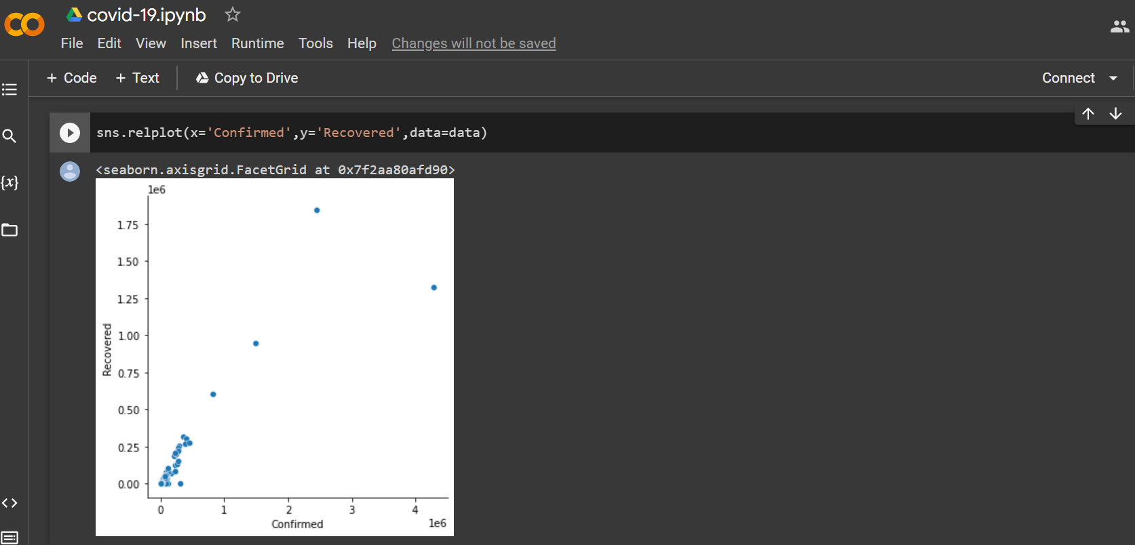
Relating the Variables with scatterplots

Slide 15
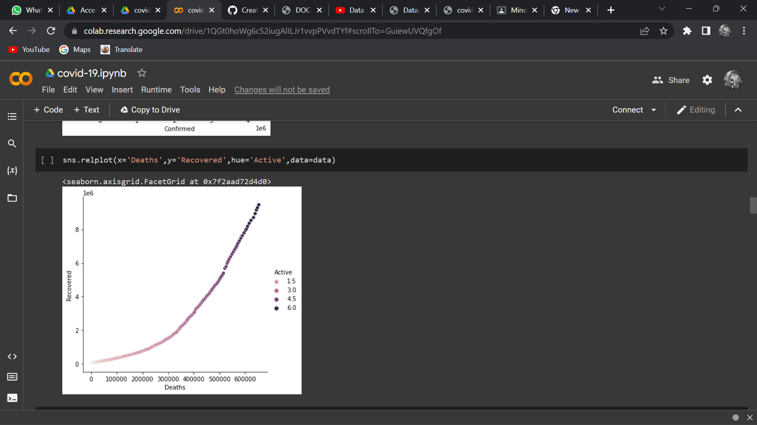
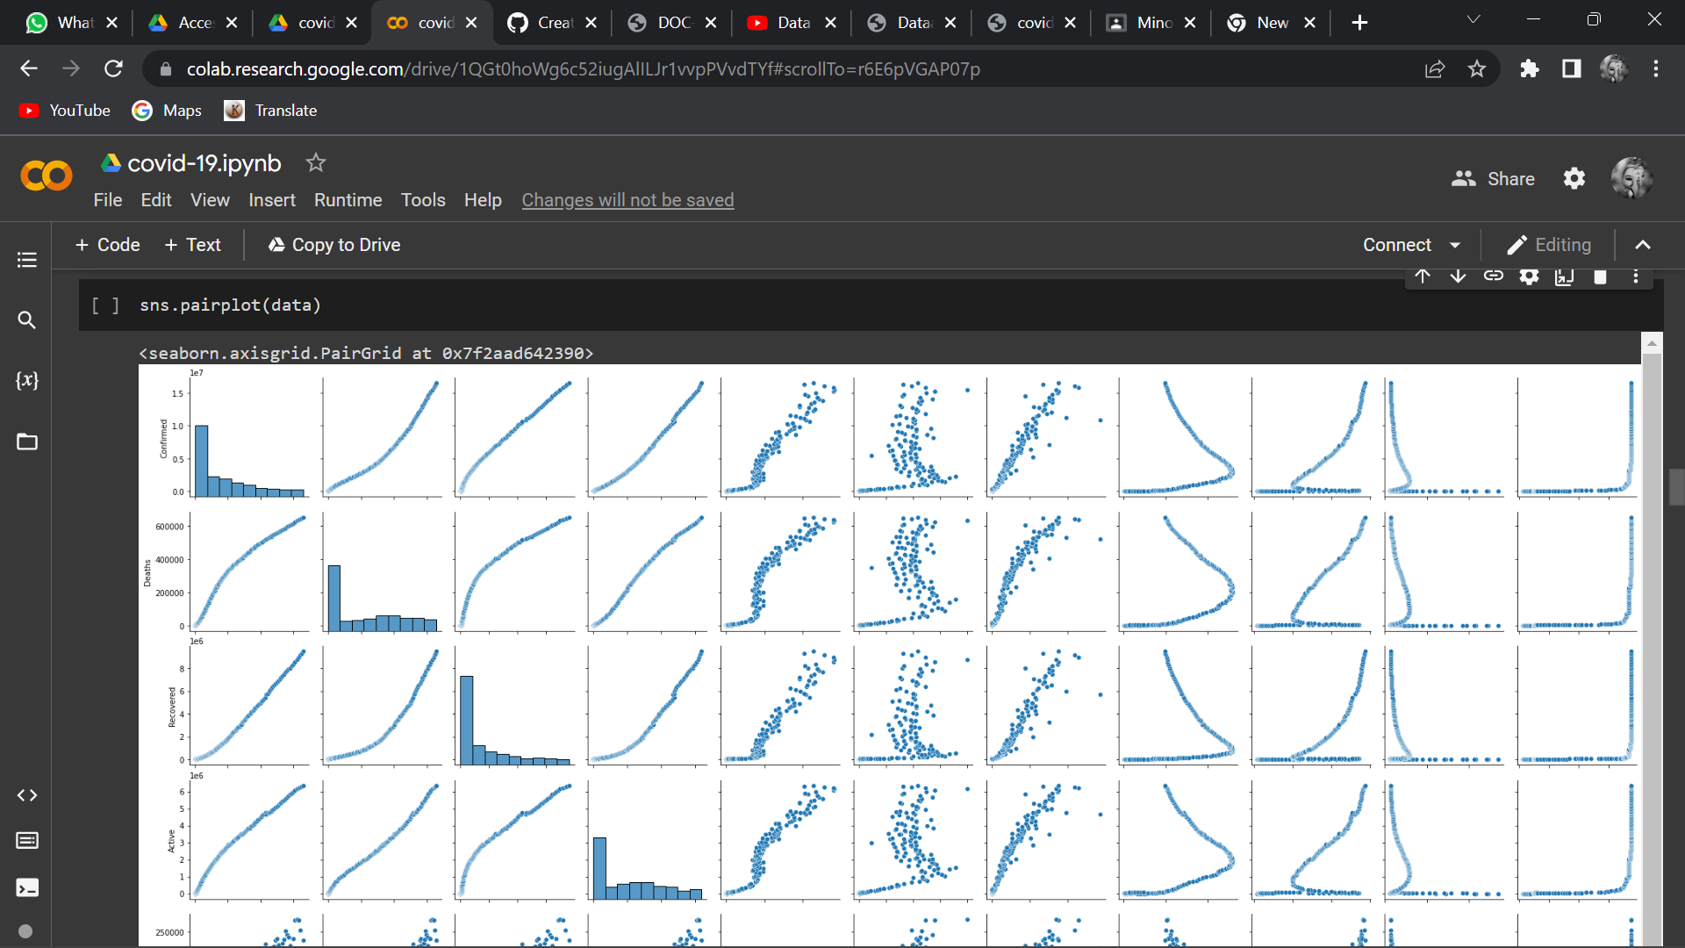

Slide 16
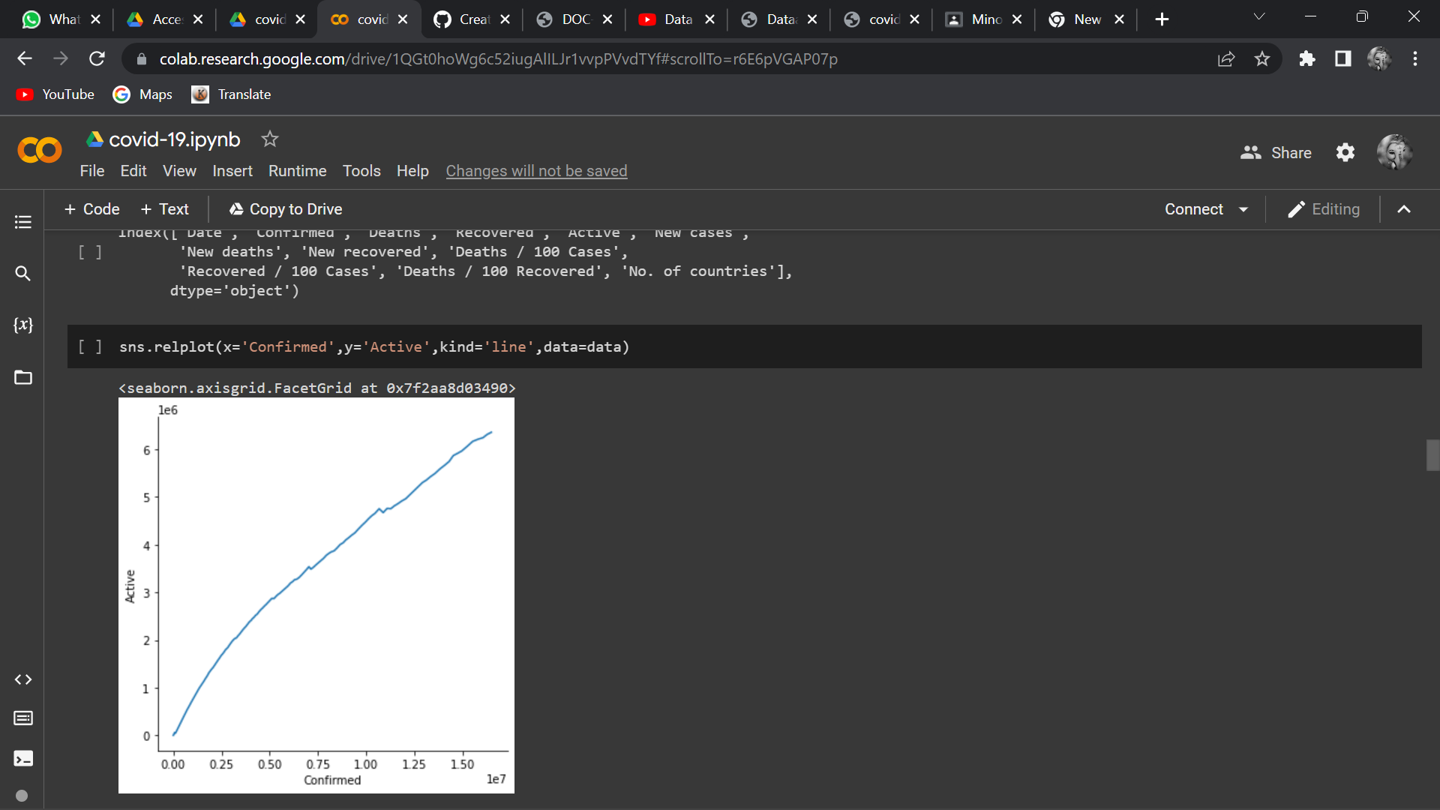
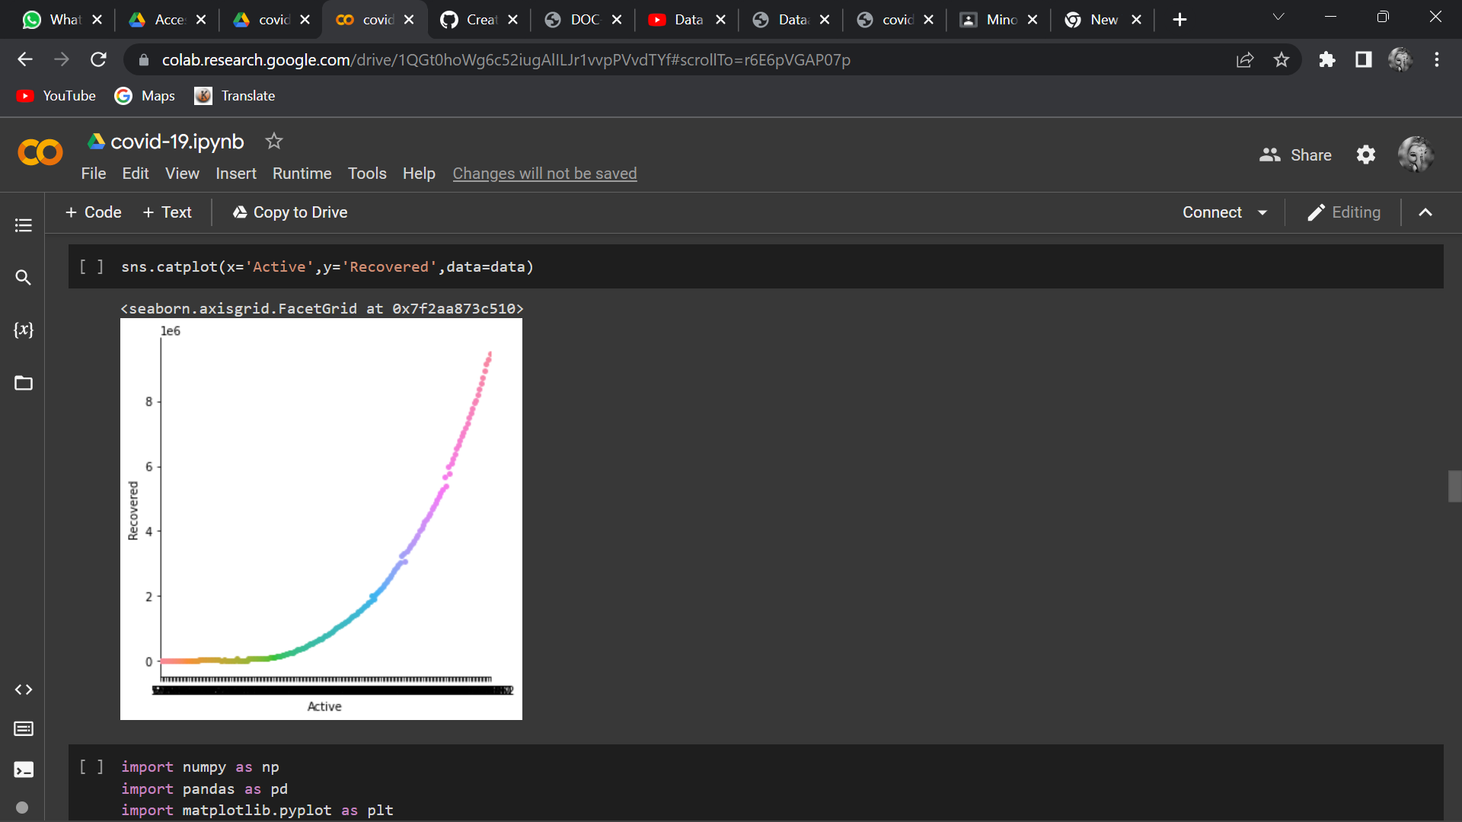

Slide 17
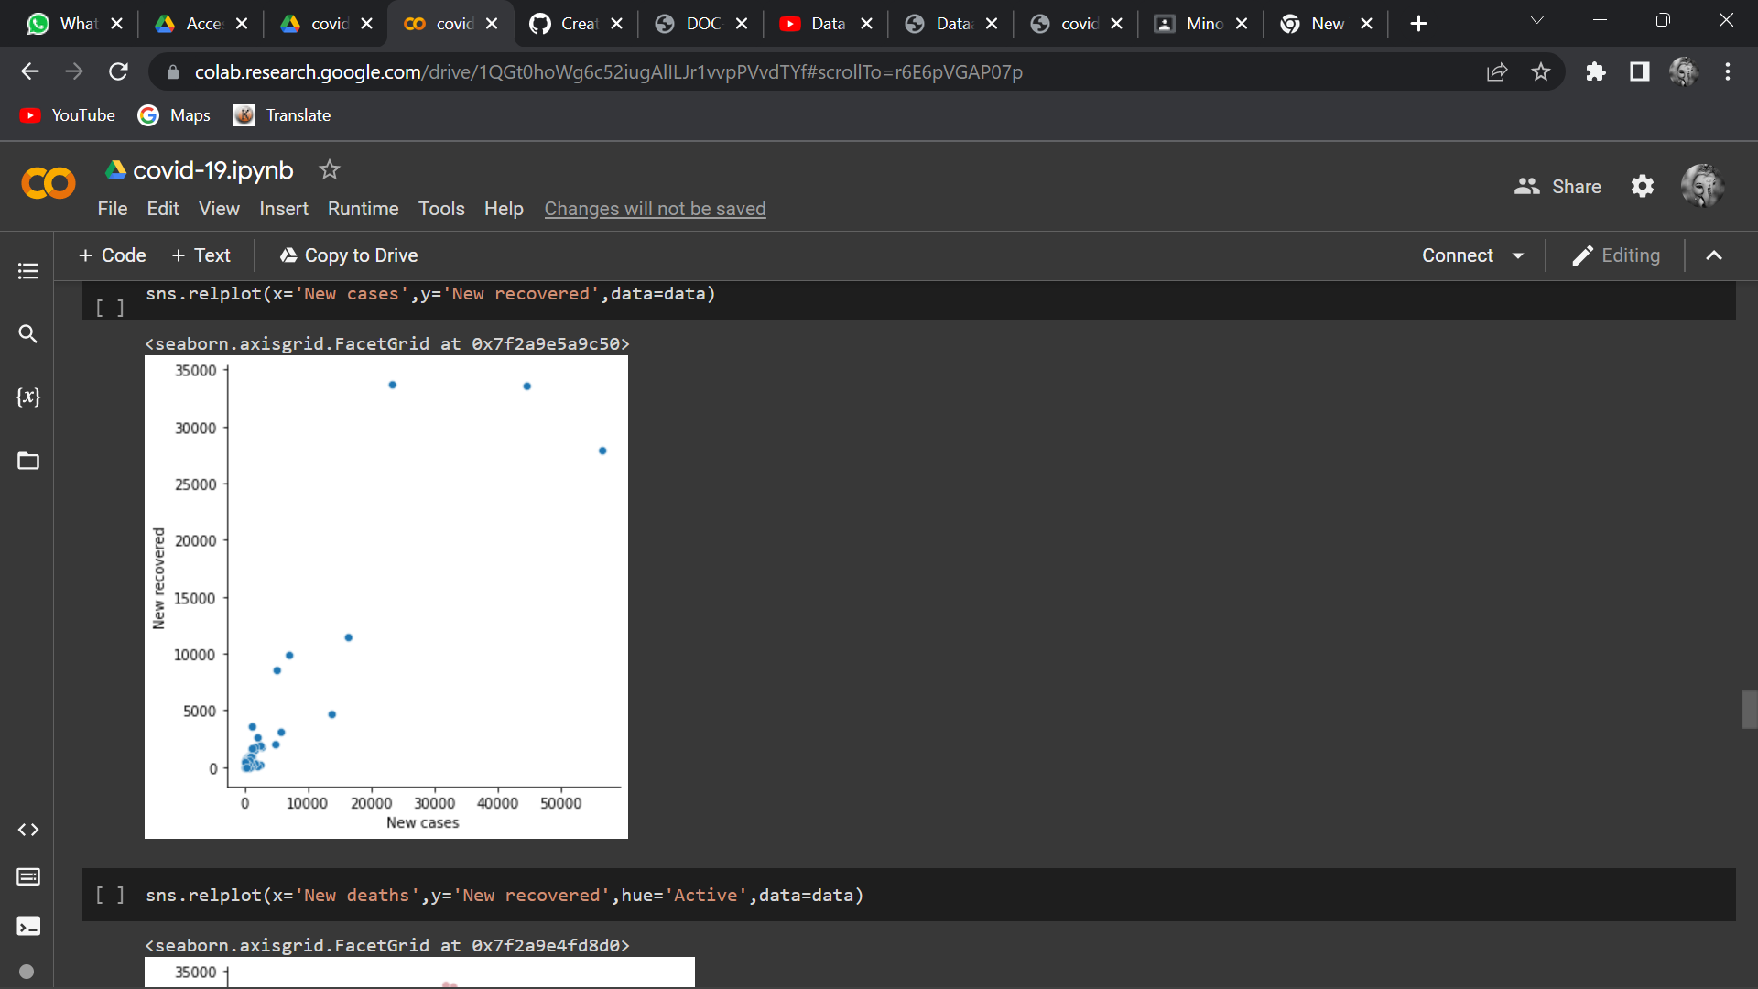
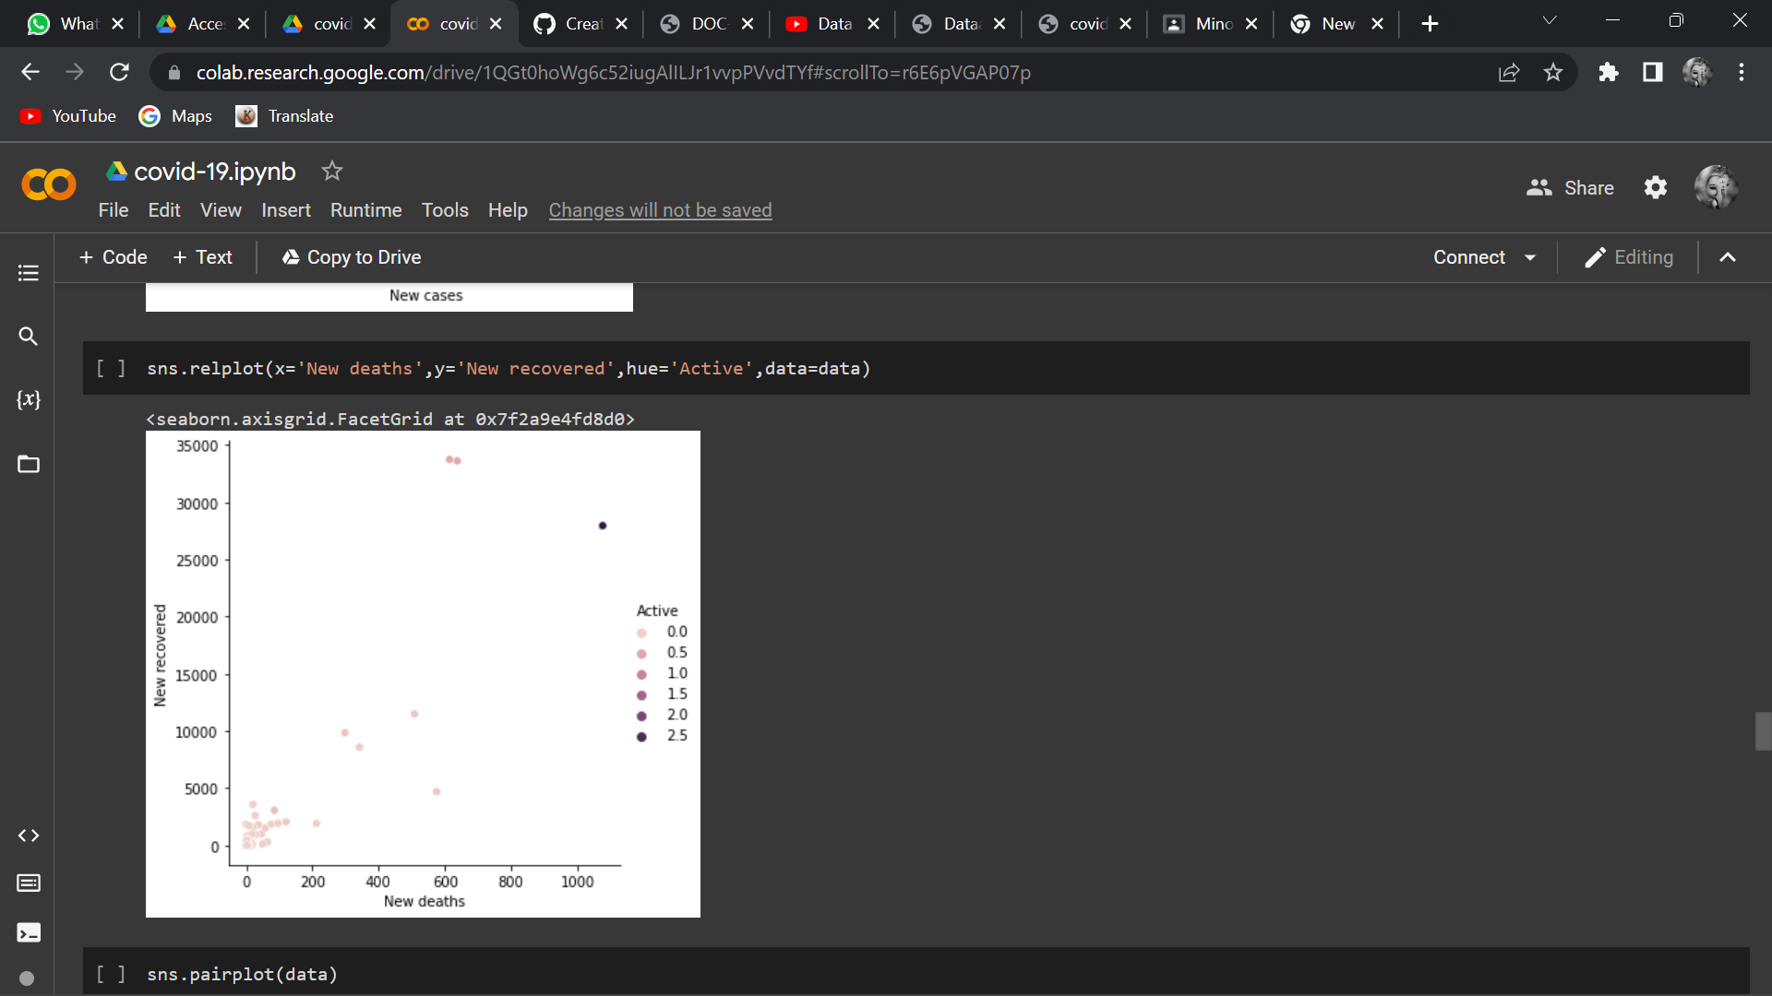

Slide 18
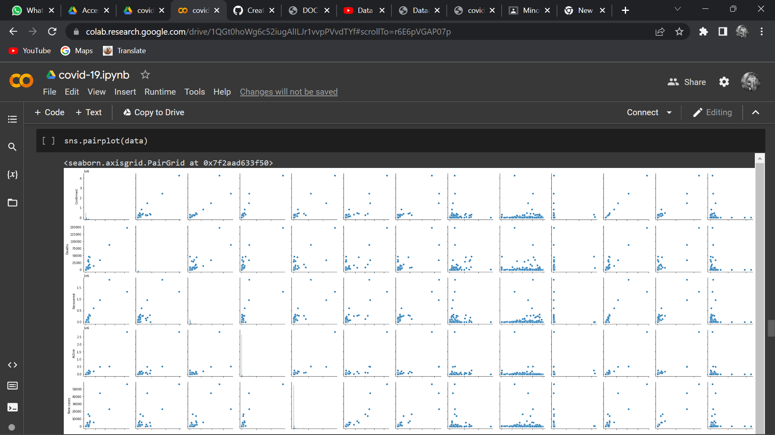


Slide 19
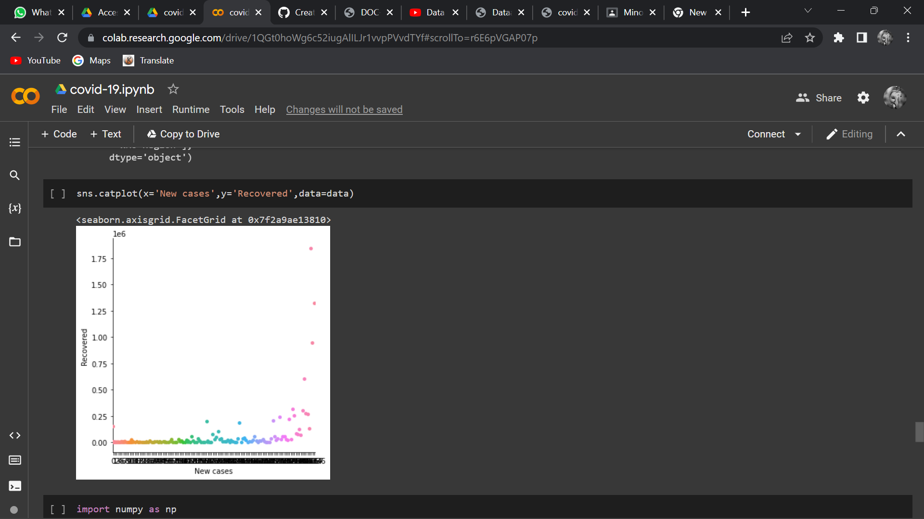

Slide 20
Conclusion:- COVID-19 outbreak which took place in China was recorded and visualized through different online platforms. Data analysis was done through several methods. Exploratory Data Analysis was used to analyze data and visualize the dataset provided by different sources regarding the emergence of the disease. Visual Exploratory Data Analysis (EDA) was used as a method to analyze the rate at which COVID-19 was spreading throughout the globe. In this method, the data was analyzed through a map that helps an individual to understand the epidemiological nature of COVID-19. Susceptible-Exposed-Infectious-Recovered (SEIR) model was used to predict the time and the rate taken for the spreading up of disease throughout the globe. In this modeling method, real-time data was collected and visualized to forecast the rate of increasing cases for COVID-19 and was also used to forecast the analysis of infection. The results from the SEIR model were further used to analyze data for sentiment analysis among the community regarding the outbreak of COVID-19. The COVID-19 outbreak spreads not only through the country’s policy but also through the social responsibility of each individual. The different online platform, updates the viewers with the situation of the disease including the number of confirmed cases, number of recoveries and number of deaths taking place throughout the world. Data analysis for COVID-19 is done to make aware humans against the infection caused by Corona.

